Slide 1



Github-Trending-Repositories

Slide 2
Agenda
Business Problem
Project Objective
Tools & Technologies
Web Scraping & Data Collection
Dataset & Data Preprocessing
Exploratory Data Analysis & Visualization
Statistical & Hypothesis Testing
Key Business Insights
Conclusion

Slide 3
Business Problem
GitHub contains a large number of repositories across different technologies, topics, and programming languages. It is difficult to systematically identify which repositories are popular within specific topics and compare repository popularity across different categories and programming languages.
This project addresses this problem by collecting GitHub repository data through web scraping and analyzing repository popularity using GitHub Stars. The analysis helps identify popular repositories, compare popularity across topics and categories, and understand the programming languages associated with popular repositories.

Slide 4
Project Objective
Collect GitHub repository data from different technology categories and topics using web scraping.
Clean and prepare the scraped dataset for accurate analysis by handling duplicates, missing values, and data inconsistencies.
Analyze repository popularity using GitHub Stars and examine how popularity varies across topics, categories, and programming languages.
Compare repository popularity across different technology categories and topics to identify popular areas and repositories.
Create meaningful features and perform statistical analysis to identify popularity patterns and derive actionable business insights from the scraped GitHub data.

Slide 5
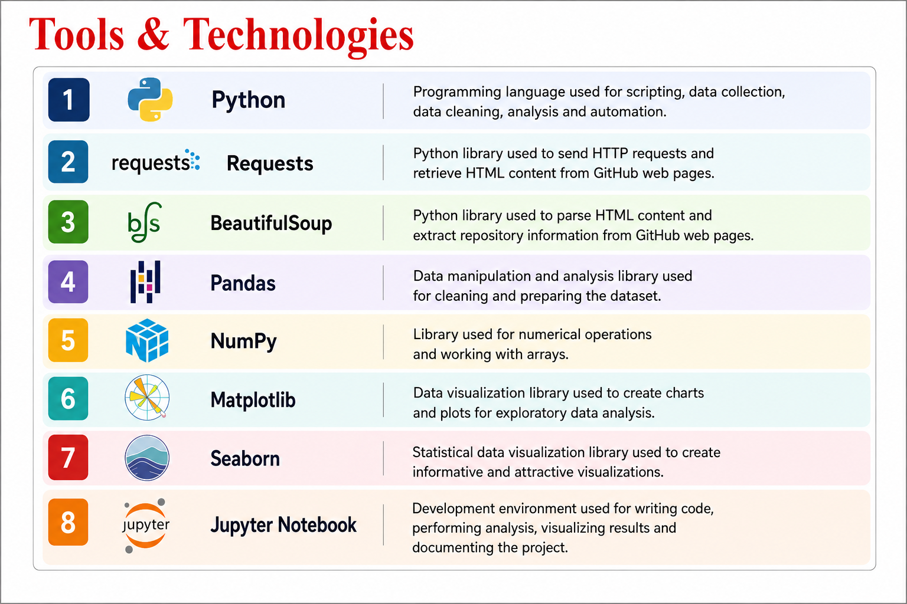
Tools & Technologies

Slide 6
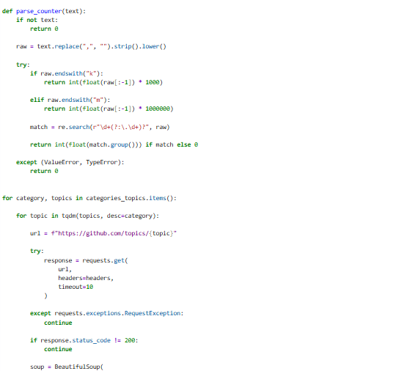
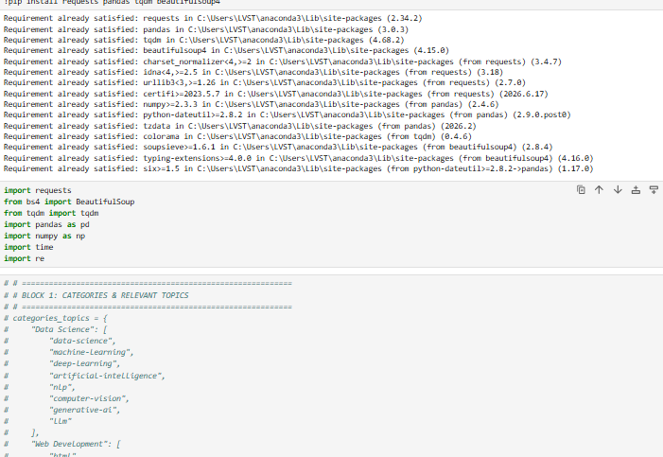
Web Scraping & Data Collection
Source: GitHub repository data
Tools Used: Python, Requests, BeautifulSoup, Pandas & NumPy
Collected repository data from different GitHub technology categories and topics.
Extracted key details such as repository name, owner, programming language, stars, and repository URL
Collected and combined the repository records into a single dataset.
The collected data was then prepared for cleaning, preprocessing, EDA, visualization, and further analysis.

Slide 7
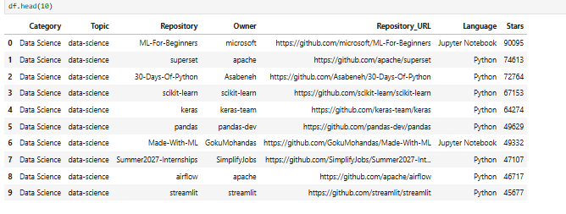
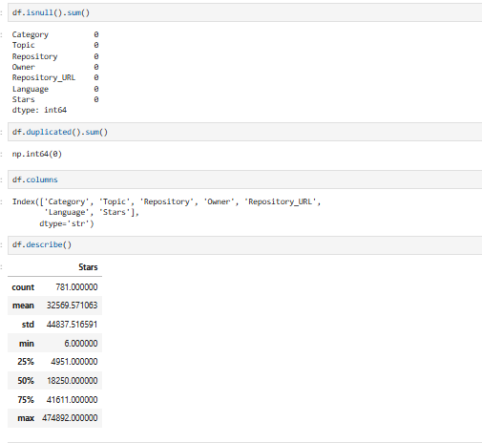
Dataset & Data Preprocessing
Dataset Overview
The final dataset contains 781 GitHub repository records and 7 columns.
The key fields include Category, Topic, Repository, Owner, Language, Stars, and Repository URL.
The dataset was examined for its structure, data types, missing values, and duplicate records.
The scraped data was cleaned and prepared for Exploratory Data Analysis and visualization.
Data Preprocessing
Identified and handled missing values.
Checked for duplicate records.
Checked for invalid values such as negative Stars.
Cleaned categorical data by removing unwanted spaces and inconsistencies.
Detected potential numerical outliers in Stars using the IQR method.
Validated the cleaned dataset before EDA.

Slide 8
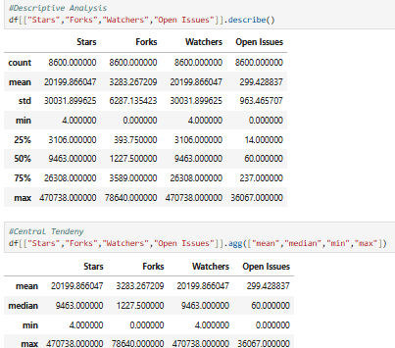
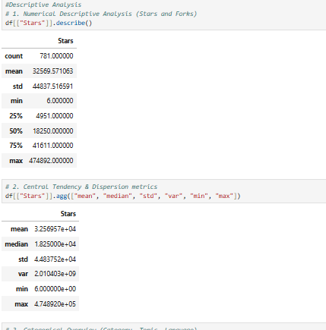
Exploratory Data Analysis
Repository Popularity
Stars show large variation across repositories.
Highly popular repositories have much higher stars counts.
This shows that GitHub repositories have different levels of popularity and developer activity.
Central Tendency & Dispersion
Stars have a high average value.
Mean and median values are different, showing some highly popular repositories.
Stars show high variation across the repositories.
This indicates different levels of repositories popularities

Slide 9
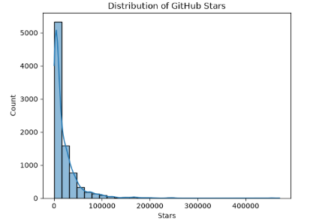
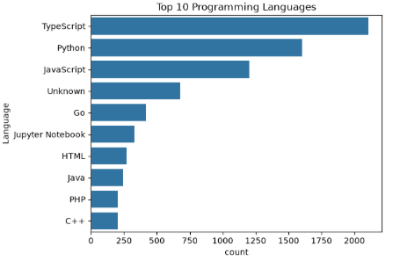
Univariate Analysis
Distribution of Stars
Most repositories have fewer stars.
Only a small number of repositories have very high stars.
This shows that GitHub star counts are highly varied.
A few popular repositories have much higher popularity than others.
Top 10 Programming Languages
TypeScript has the highest number of repositories in the dataset.
Python and JavaScript are also widely used.
Languages like Go, Java, PHP, and C++ have fewer repositories compared to the top languages.
TypeScript, Python, and JavaScript are the most represented languages in this dataset.

Slide 10
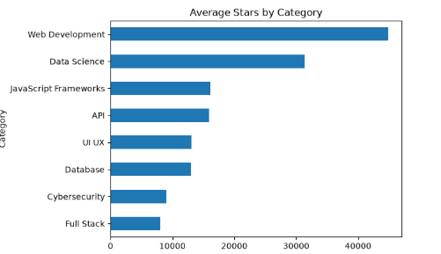
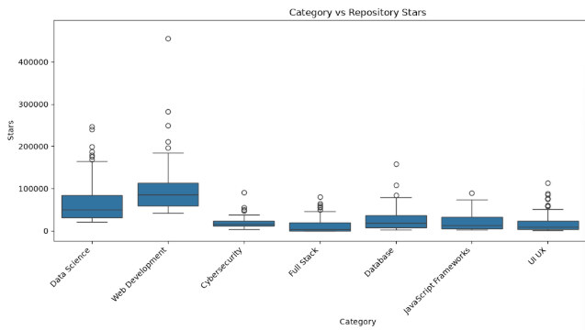
Bivariate Analysis
Average Stars by Category
Web Development has the highest average stars.
Data Science is the next highest category.
This shows that some technology categories have higher repository popularity than others.
Category-wise Repository Popularity
Web Development has the highest median Stars among the categories.
Data Science also shows relatively high repository popularity compared with most other categories.
Web Development and Data Science contain several highly popular repositories, visible as high-value outliers.
Cybersecurity, Full Stack, JavaScript Frameworks, and UI/UX generally have lower median Stars compared with Web Development.

Slide 11
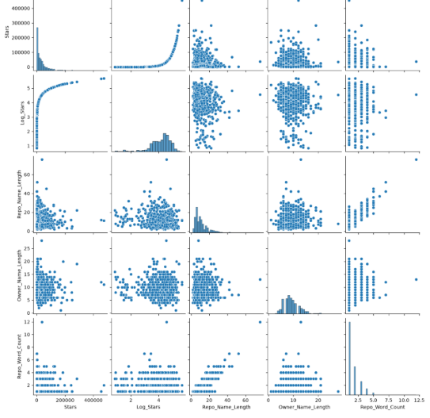
Multivariate Analysis
Feature Relationships
Stars are highly right-skewed, with most repositories having relatively fewer stars and a small number having very high stars.
Log_Stars provides a compressed view of Stars, making the distribution and relationships easier to analyze.
Repository Name Length and Owner Name Length show limited visible relationship with Stars, suggesting naming length alone does not strongly explain repository popularity.
Repository Word Count has a positive relationship with Repository Name Length, as longer repository names generally contain more words.

Slide 12
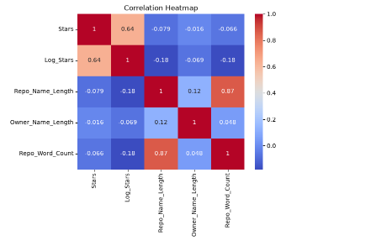
Correlation Analysis
Correlation Analysis
Stars and Log_Stars show a moderate positive correlation (0.64) because Log_Stars is derived from Stars.
Repository Name Length and Repo Word Count show a strong positive correlation (0.87), meaning longer repository names generally contain more words.
Stars and Repository Name Length have a very weak negative correlation (-0.079), indicating that repository name length has almost no relationship with popularity.
Stars and Owner Name Length show an almost zero correlation (-0.016), indicating no meaningful linear relationship.
Overall, repository naming characteristics show little relationship with repository popularity based on Stars.

Slide 13
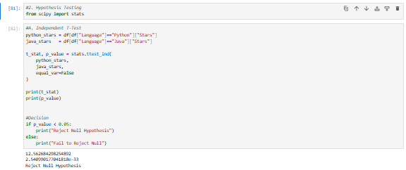
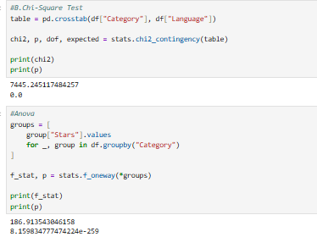
Statistical & Hypothesis Testing
Independent T-Test
Used to compare the Stars of Python and Java repositories.
The test checks whether the difference in average Stars between the two groups is statistically significant.
The p-value is less than 0.05, so we reject the Null Hypothesis.
This indicates a statistically significant difference in Stars between Python and Java repositories.
Chi-Square Test & Anova Test
Chi-Square Test examines whether Category and Language are significantly associated.
ANOVA Test compares the average Stars across different Categories.
Both tests have a p-value less than 0.05, so the Null Hypothesis is rejected.
The Chi-Square result indicates a significant association between Category and Language.
The ANOVA result indicates a statistically significant difference in average Stars across categories.
ANOVA Test

Slide 14
Key Business Insights
Web Development shows the highest average repository popularity based on Stars.
Python, TypeScript, and JavaScript are among the most common programming languages in the dataset.
Repository popularity varies considerably across categories, with a few repositories having exceptionally high Star counts.
A small number of repositories account for a large share of the highest Star counts.
The Chi-Square test shows a statistically significant association between Category and Language.
The ANOVA test shows that average repository Stars differ significantly across categories.
The analysis identifies the most popular repositories within each GitHub topic based on Stars.

Slide 15
Conclusion
GitHub repository popularity varies significantly across different categories and topics.
Stars provide a useful metric for comparing repository popularity within the scraped dataset.
Programming language and technology category help identify patterns in repository popularity.
Statistical analysis revealed significant differences in average Stars across categories and a significant association between Category and Language.
Overall, the analysis helps identify popular repositories, compare technology areas, and understand GitHub repository popularity patterns.

Slide 16

THANK YOU

